Slide 1
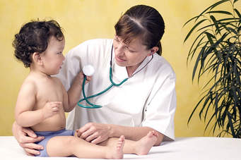
Communication Skills (CS) in Practice

Slide 2
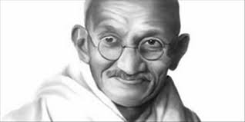
Bombay Hospital
A patient is the most important person in our hospital.
He is not an interruption to our work, he is a purpose of it.
He is not an outsider in our hospital. He is part of it.
We are not doing a favor in serving him,
he is doing us a favor by giving us opportunity of serving him.

Slide 3
learning objectives
Reasoning behind focusing on communicating skills in consultation
What is the health related outcome of good consultation
principles of model of consultation
What is the triadic consultation
Revised content guide to medical interview
focusing on : Initiating the interview and building the relationship (rapport) with parents and their children

Slide 4
The Consultation
Is meeting of experts
A good Consultation allows real needs of the patient to be identified and addressed.

Slide 5
In consultation patient looks for
A Human touch
Up to date Care

Slide 6
Teaching CS
Communication skills can be taught
BUT
In a large survey showed that 55% of consultant felt they had inadequate training

Slide 7
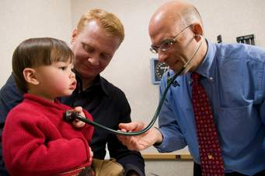
Patient's satisfaction
Increased by discovering and acknowledging patient's expectation

Slide 8
How many impression do patient make on us in first meeting?
11!

Slide 9
How long do they take to make these impressions?
7 seconds!!
Mike Grecco 2003

Slide 10
Model of consultations

Slide 11
ICEE & F
Ideas and beliefs
Concerns: worries about what might the symptoms means?
Expectations: what the patient expect from the visit or how the doctor might help?
Effect on life: How the illness affects the patient's daily activities?
Feelings: the obvious emotion that might be produced by the illness.
Notes:
Thus the new content of the medical interview that the student should consider is:

Slide 13
ILS
Invite: Invitation to tell a story
Listen carefully and patiently
Summarize regularly

Slide 14
Communicating with children and parents
It is vital to remember that the child is the patient but that the parent is also a Key person in many transactions.
This triadic consultation, in which the doctor has to communicate with both parents and children at the same time, it needs individual attention

Slide 15
It is important to start the interview
addressing the child and not to direct all your attention to the parent(s)
Ask young children whether they would like to tell their story or would prefer their parents to do so.
Notes:
Children often have their own needs, and addressing these can improve their satisfaction and adherence to treatment

Slide 16
Many pediatric problems that are brought to medical attention are:
Minor but can cause significant parental anxiety
Serious childhood illness is overwhelming for all parents.
In both circumstances parental satisfaction is closely related to addressing of parental concerns and expectations during a consultation

Slide 17
Parents tend to interrupt their children during medical interviews
They may disagree with their child's view of the problem
Valuing children of all ages and respecting their views is more likely to encourage the development of successful relationships between you and your young patients
Notes:
a it is useful to pick up cues from both parents and children when there is disagreement, particularly if the problem is a behavioral one.

Slide 18
Most of the skills that underlie the successful paediatric consultation are based on the core skills of consultations with adult patients,

Slide 19
The sections of the consultation which need particular focus are: Initiating the interview and building the relationship(rapport)
It will ensure the patient's comfort and assurance throughout the consultation,
Will have the way for what may be difficult or painful examinations or investigations later on.

Slide 20
Elements of Communication
Sender Receiver
Feedback
Message
Notes:
Teacher Notes:
Describe the elements of the communication model.

Slide 21
start
Wipe
Wash hands
Introduce self (full name and grade)
Patients name and date of birth and what they like to be called
Explain why you are here

Slide 22
Briefly mention confidentiality
Start with an open question and try not
interrupt patients answer

Slide 23
Invite ,listen ,summarize –ILS) ) During
start with open question and progress to closed question
build a rapport
use signposting
Show empathy
Response to cues
listen to what patients are saying
Don’t think of the next question
Cues may be verbal or non verbal body language
Repeat a cue and ask more about

Slide 24
End
Summarize
Ask if they have any question
Explain the next steps

Slide 25
Integrate ideas , concern and expectation (ICE)
Never
Ask leading questions
Give multiple answers /questions in on go

Slide 26
Key tips for communicating with examining children
Major points
Keep using their names
Make it a game
Keep interacting and asking questions

Slide 27
Other tips
If the child crying , let them calm down
Involve child when ever possible
Even babies like to hear reassuring voice
Befriend child before examining
Get at their level
Distract with toes
Use parents to distract them
Undress in stages
Reward child and praise them
Etc..

Slide 28
Create a rapport quickly
Introduce self to every one in the room
Refer to the patient by name
Acknowledge wait
Make social comment or ask non medical question
Convey knowledge of pt’s history by comment on prior visit or problems
Consider patients cultural background and use appropriate gestures, eye contact, and body language

Slide 29
Summary
Quality of care depends a lot on good communication with families
Good communication depends a lot on listening to our patients and showing empathy.
Good listening means good care.
Parents are not looking for how much you know but how much do you care.

Slide 30
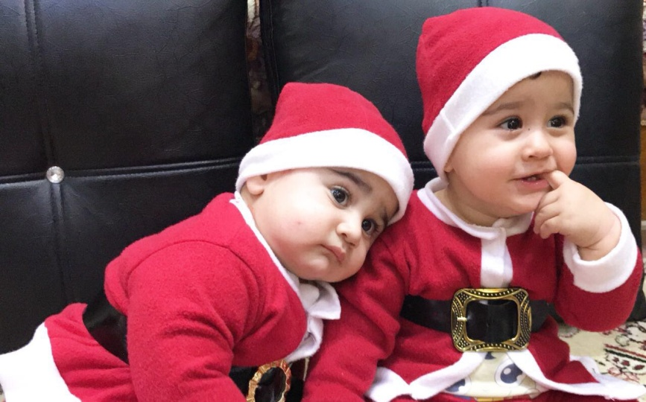
Thanks for your attention

